Slide 1
Amazon Business Research Analyst Challenge
Gender neutrality and Inclusion
Sneha Rawat

Slide 2
Problem Statement:
Determining the right fit using fitment % percentage and factor that influences relevancy for each job code profile for the applications received maintaining a fair and equitable approach.
Approach:
Build an ML model to predict fitment percentage and bias influential factor using top relevant feature variables based on the applications received last year for each job code profile which can be used to analyze and enable an equal opportunity.

Slide 3
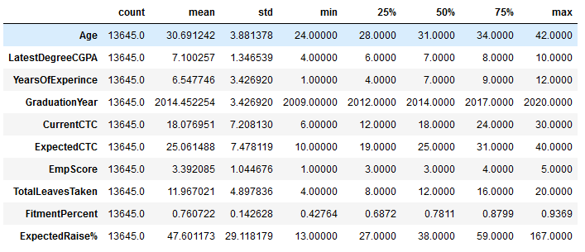
Data Exploration and Preprocessing:
Data Set: Contains all records of applications received last year for each job code profile.
Train.csv: 13645 * 22
Test.csv: 8745 * 20
Check Missing Values:
Filled the null data in Bias Influential Factor with value ‘None’ in the dataset.
Basic Statistical Measures:
All numerical attributes

Slide 4
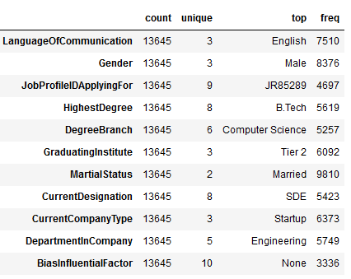
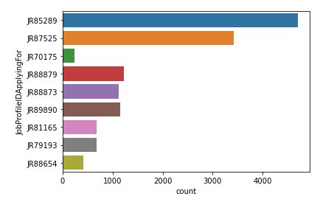
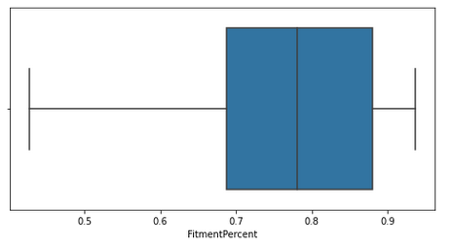
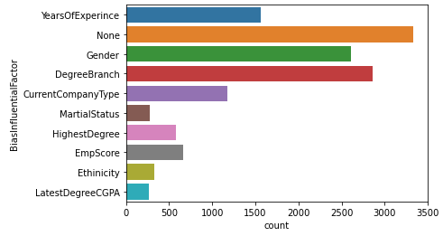
All categorical attributes
Most of applications for job id: JR85289 and least for job id: JR70175
Target Variable:
Fitment % and Bias Influential Factor

Slide 5
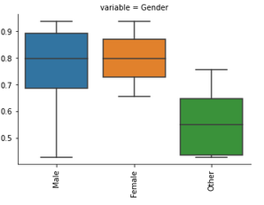
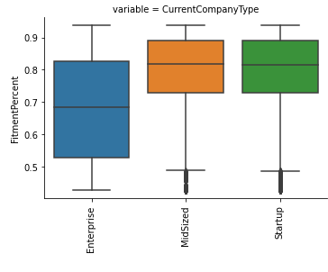
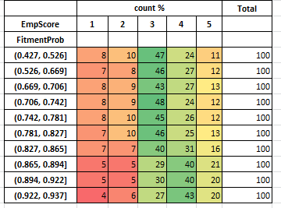
Fitment % vs Gender
Low fitment percent for the other gender category, while females have higher fitment percent as compared to the males.
Fitment % vs Current Company Type
Startup and Mid-Size company type have high fitment percent as compared to Enterprise
company type.
Fitment % vs EmpScore

Slide 6
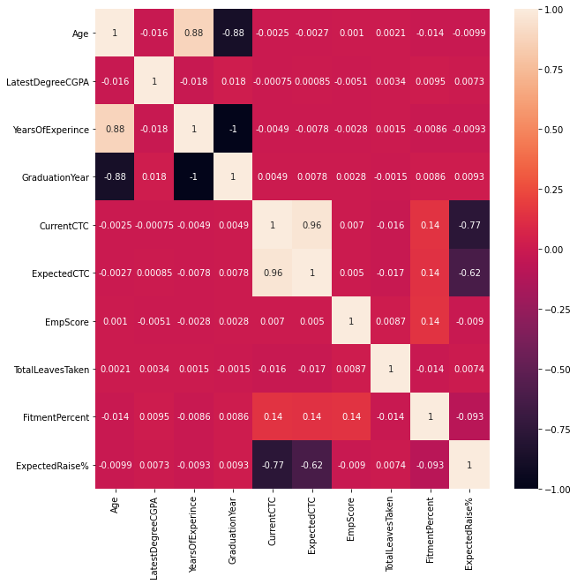
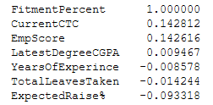

Feature Selection
Checked the correlation of the dataset. Attached heatmap is showing all the correlated features in the dataset.
Features with value > 0.8: Age, ExpectedCTC, YearsOfExperience
Fitment % Correlated features:
Used RFE method to select the features:

Slide 7
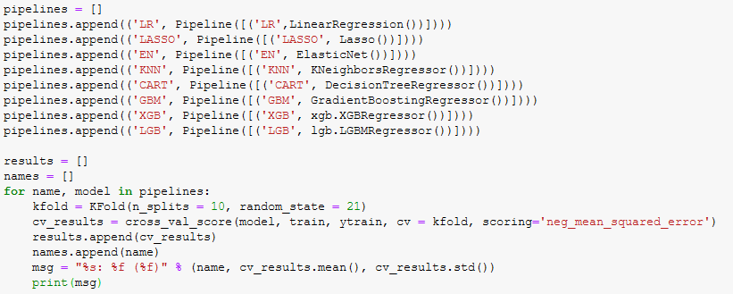
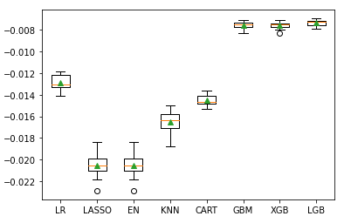
Model Selection
LR: -0.012872 (0.000713)
LASSO: -0.020506 (0.001214)
EN: -0.020506 (0.001214)
KNN: -0.016991 (0.001166)
CART: -0.014544 (0.000499)
GBM: -0.007618 (0.000343)
XGB: -0.007619 (0.000333)
LGB: -0.007364 (0.000294)
LightGBM performs the best.

Slide 8
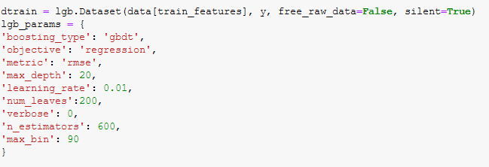
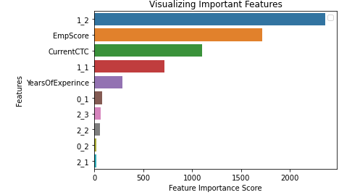
Model Building and Evaluation
LightGBM Regressor
Target variable: Fitment%
Performance evaluation metrics:
R-squared(R2): 0.4372
Adjusted R2 score: 0.4316
Root Mean Squared Error (RMSE): 0.0880
Top predictors include:
Gender, EmpScore, CurrentCTC,
YearsOfExperience, LanguageOfCommunication,
JobProfileIDApplyingFor.

Slide 9
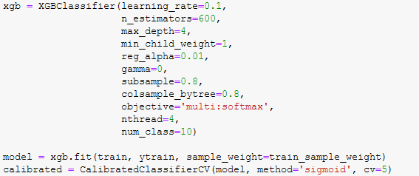
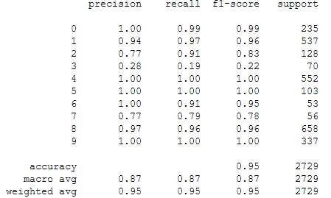
XGBClassifier with created sample balanced weights:
Target variable: BiasInfluentialFactor
Performance evaluation metrics:
{0: 'CurrentCompanyType', 1: 'DegreeBranch',
2: 'EmpScore', 3: 'Ethinicity', 4: 'Gender',
5: 'HighestDegree', ', 6: 'LatestDegreeCGPA‘
7: 'MartialStatus', 9: 'YearsOfExperince', 8: 'None' }
Top predictors include:
Gender, CurrentCompanyType, EmpScore
JobProfileIDApplyingFor, HighestDegree.
This shows that our validation prediction is having accuracy , precision and recall score in an acceptable range and is stable with good accuracy and recall/sensitivity except for Ethinicity.
And, final for test set we used the model to predict bias influential factor using the predicted fitment %.

